Slide 1
Unit 1.2 Review

Slide 2
What is DNA?

Slide 3
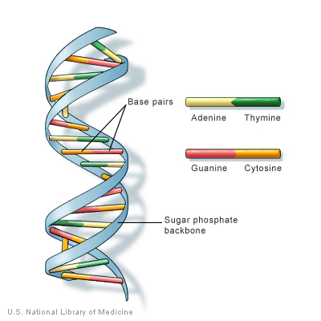
DNA – Deoxyribose Nucleic Acid (It is a type of Nucleic Acid that contains a Deoxyribose sugar)
Shape of a Double Helix – Two strands that are twisted
Made of nucleotides – Repeating units of DNA

Slide 4
Sugar Phosphate Backbone - The outside of the DNA molecule is composed of sugar and phosphate molecules connected together
Nitrogenous Bases – Connect the two strands of the DNA together and found in the middle of the DNA molecule

Slide 5
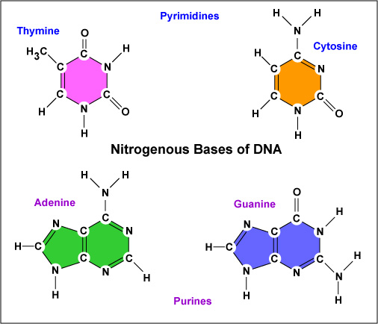
Nitrogenous Bases
Purines
Have two rings
Adenine
Guanine
Pyrimidines
Have one ring
Cytosine
Thymine
Base Pairing
A pairs with T and has two hydrogen bonds
G pairs with C and has three hydrogen bonds

Slide 6
How do scientists isolate DNA in order to study it?

Slide 7
1. If using plants the food needs to be mashed up first.
2. Soap solution is added to breakup the cell membrane.
3. Alcohol will separate the DNA from the rest of the liquid.
See http://learn.genetics.utah.edu/content/labs/extraction/howto/

Slide 8
How does DNA differ from person to person?

Slide 9
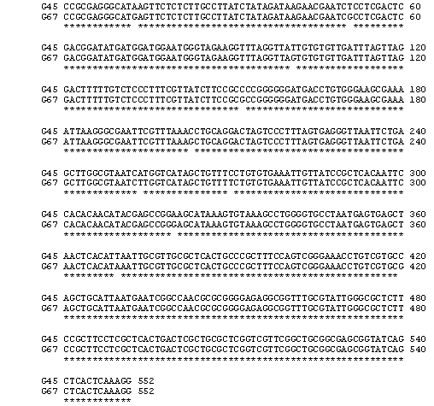
The difference between different people’s DNA is only about 0.1%
The differences are due to the sequence of bases

Slide 10
How can tools of molecular biology be used to compare the DNA of two individuals?
What are restriction enzymes?
What are restriction fragment length polymorphisms?

Slide 11
Restriction enzymes are used to cut the DNA into different sized fragments (RFLP’s) that are determined by the sequence
The DNA is run on a gel to separate the fragments and determine the length
The fragment lengths can be compared by viewing the bands on the gel
See:
http://highered.mcgraw-hill.com/olcweb/cgi/pluginpop.cgi?it=swf::535::535::/sites/dl/free/0072437316/120078/bio20.swf::Restriction%20Fragment%20Length%20Polymorphisms

Slide 12
What is gel electrophoresis and how can the results of this technique be interpreted?

Slide 13
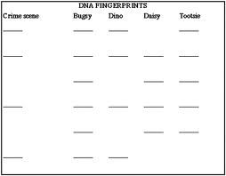
DNA is runs through the a gel, propelled by an electric current.
The DNA moves towards the positive charge since the molecule is negatively charged.
The smaller
fragments move
farther through the
gel than the larger
fragments
The DNA shows
up as bands on the
gel

